Slide 1

Hospitality Project

Slide 2
Project Contributors
- KABILAN S
- SAKSHI EKBOTE
- PRACHI KHAIRNAR
- SAGAR DHONDU PALKAR

Slide 3
Total Revenue
1708771229
Occupancy
57.86926
Cancellation Rate
24.83097
Utilize capacity
232576
Total Booking
134590

Slide 4
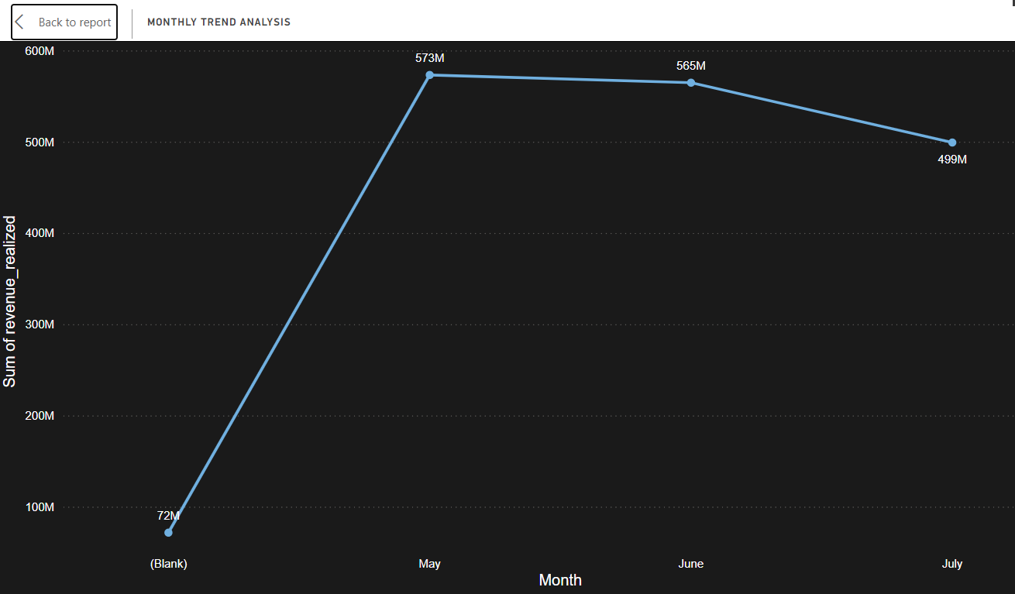
WEEKLY TREND ANALYSIS
TREND ANALYSIS CHART
EXPLAINATION
We can compare here revenue with the past month revenue .
In April we have amount around Rs 72 m revenue
In may the revenue is highest at 573 m .
In June revenue is slightly decreasing to 565 m .
and in July revenue is 499 m.

Slide 5
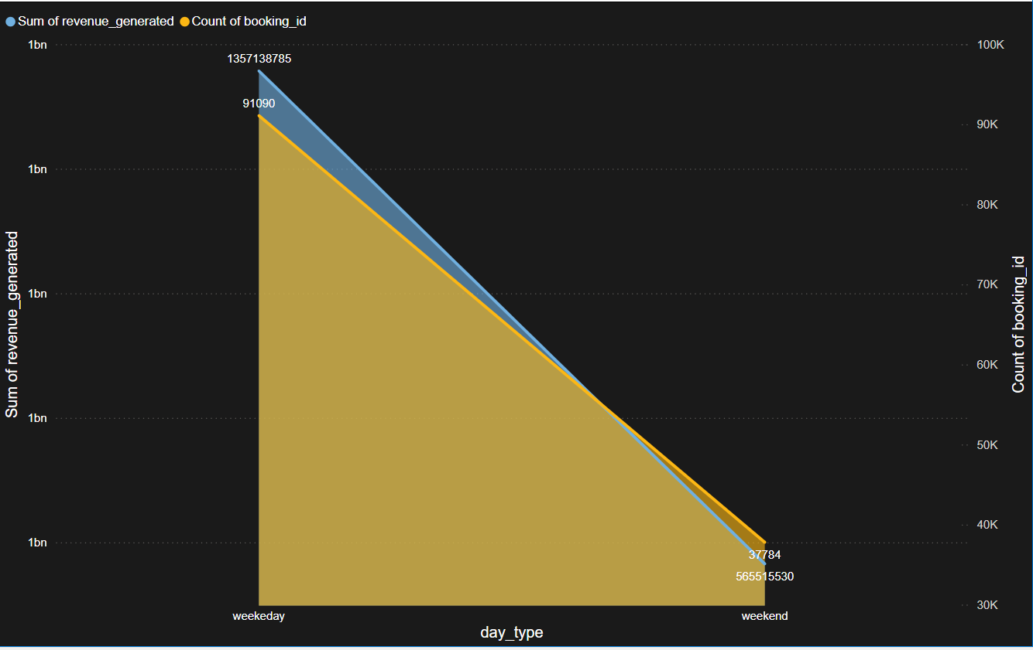
Weekday & Weekend Revenue and Booking
EXPLAINATION
On weekday Revenue is about 1415 millions and booking count is 91090
On weekend revenue is about 592 millions and booking count is 37784
Observation: Revenue on weekends is significantly lower than weekdays, possibly due to fewer bookings or lower property utilization.
CHART

Slide 6
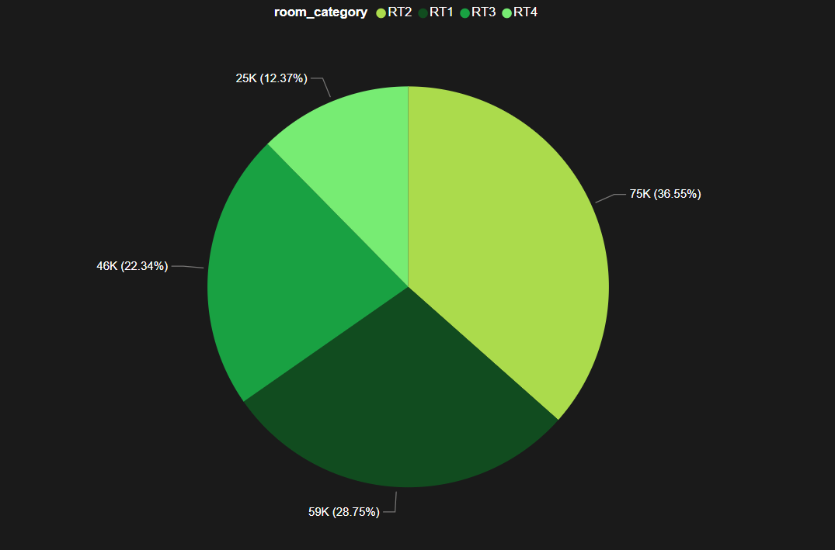
CATEGORY WISE REVENUE
EXPLAINATION
Highest revenue is generated by RT 2 with 75 K
Lowest revenue is generated by RT 4 with 25 K
RT 3 generated revenue of 46 k
RT 1 generated revenue of 59 k

Slide 7
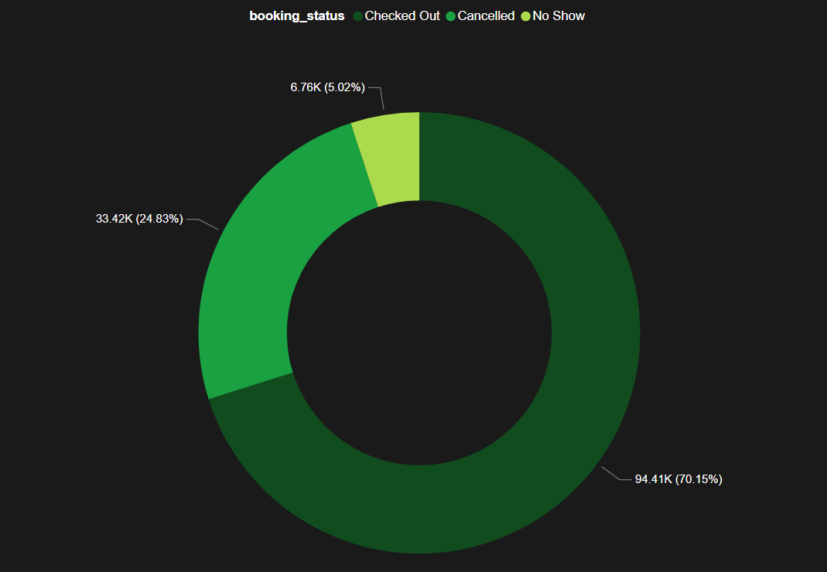
CHECKED OUT , BOOKING , NO SHOW
EXPLAINATION
Checked out bookings are 94411 which is 70.15%
Cancelled booking count is 33420 which is 24.83%
No show booking count is 6759 which is 5.02%
CHART

Slide 8
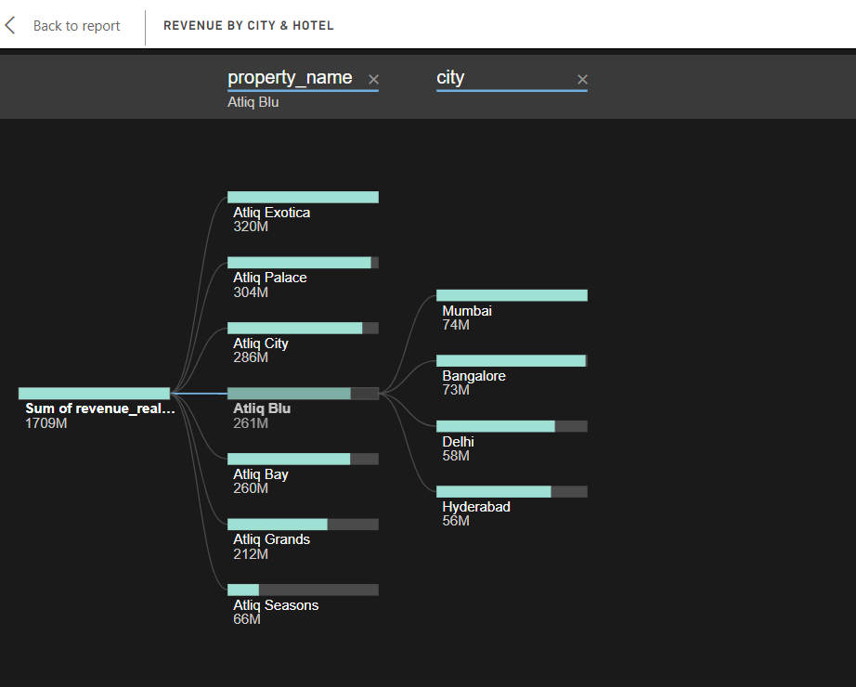
Revenue by State & hotel
EXPLAINATION
Total sum of revenue by state and hotel is 1709 m
Atliq Exotica : 320 m
Atliq Ealace : 304 m
Atliq City : 286 m
Atliq Blu : 261 m
Atliq Bay : 260 m
Atliq Grands : 212 m
Atliq Seasons : 66 m
Mumbai city : 212 m
Banglore : 60 m
Delhi : 58 m
Hyderabad : 48 m
CHART

Slide 9
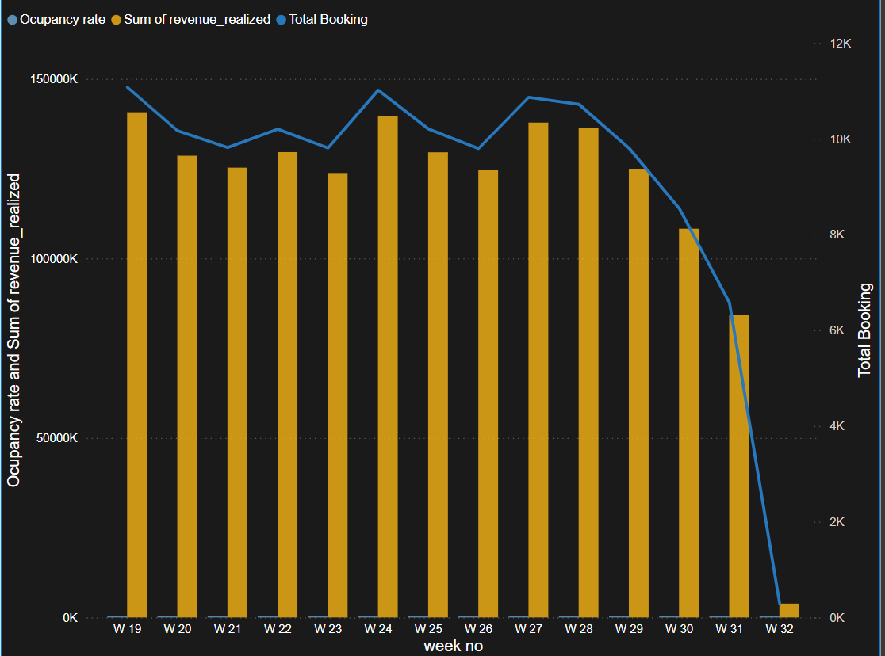
Weekly trend Key trend (Revenue, Total booking, Occupancy)
The 19 Week is highest with revenue 141 M booking count 11076
The lowest value of week is 38.4 M and booking count 290
Other weeks are performing good as compare to each other with little bit of difference

Slide 10


